Slide 1
Modern Systems Analysis and Design Fourth Edition Jeffrey A. Hoffer Joey F. George Joseph S. Valacich
Chapter 7
Structuring System Process Requirements

Slide 2
Learning Objectives
Understand logical process modeling via data flow diagrams (DFDs).
Draw DFDs of well structured process models.
Decompose DFDs into lower-level diagrams.
Balance high-level and low-level DFDs.
Explain differences between current physical, current logical, new physical, and new logical DFDs.
Use DFDs for analyzing information systems.
Explain use cases and use case diagrams.

Slide 3
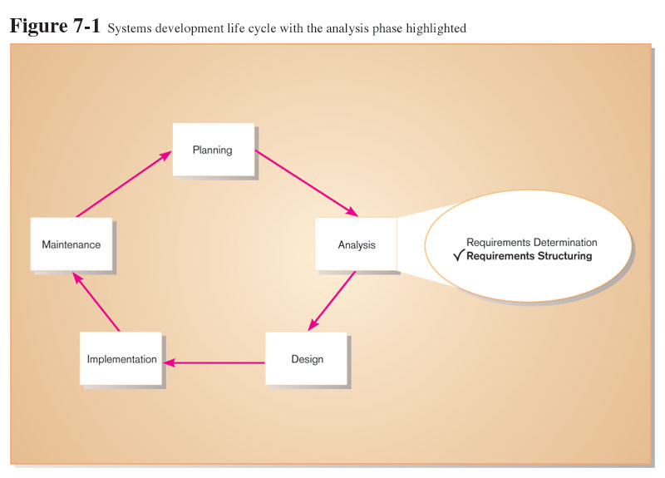

Slide 4
Process Modeling
Graphically represent the processes that capture, manipulate, store, and distribute data between a system and its environment and among system components
Utilize information gathered during requirements determination
Processes and data structures are modeled

Slide 5
Process Modeling (cont.) Deliverables and Outcomes
Context data flow diagram (DFD)
Scope of system
DFDs of current physical and logical system
Enables analysts to understand current system
DFDs of new logical system
Technology independent
Show data flows, structure, and functional requirements of new system
Thorough description of each DFD component

Slide 6
Data Flow Diagram (DFD)
A picture of the movement of data between external entities and the processes and data stores within a system
Difference from system flowcharts:
DFDs depict logical data flow independent of technology
Flowcharts depict details of physical systems

Slide 7
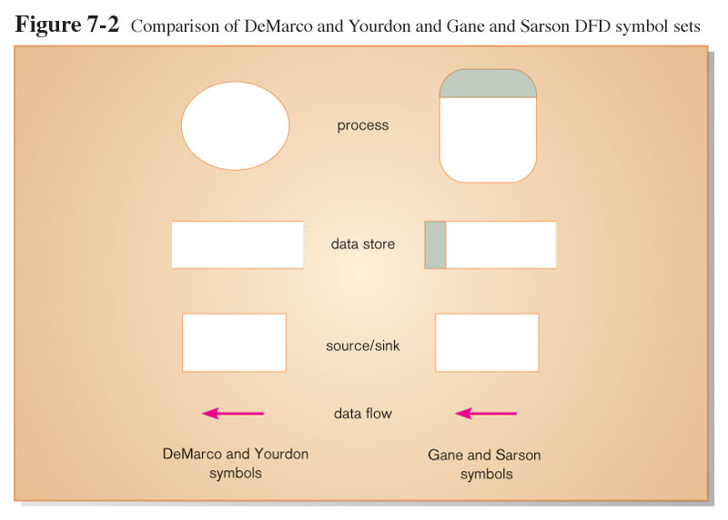
DFD Symbols

Slide 8
DFD Symbols (cont.)
Process: work or actions performed on data (inside the system)
Data store: data at rest (inside the system)
Source/sink: external entity that is origin or destination of data (outside the system)
Data flow: arrows depicting movement of data

Slide 9
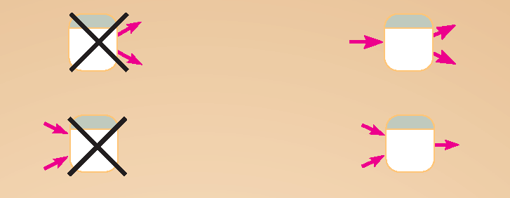
DFD Diagramming Rules Process
No process can have only outputs or only inputs…processes must have both outputs and inputs.
Process labels should be verb phrases.

Slide 10
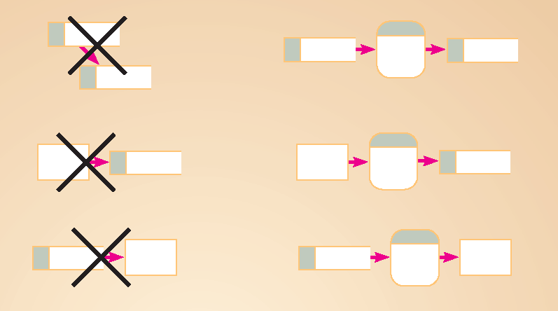
DFD Diagramming Rules Data Store
All flows to or from a data store must move through a process.
Data store labels should be noun phrases.

Slide 11

DFD Diagramming Rules Source/Sink
No data moves directly between external entities without going through a process.
Interactions between external entities without intervening processes are outside the system and therefore not represented in the DFD.
Source and sink labels should be noun phrases.

Slide 12
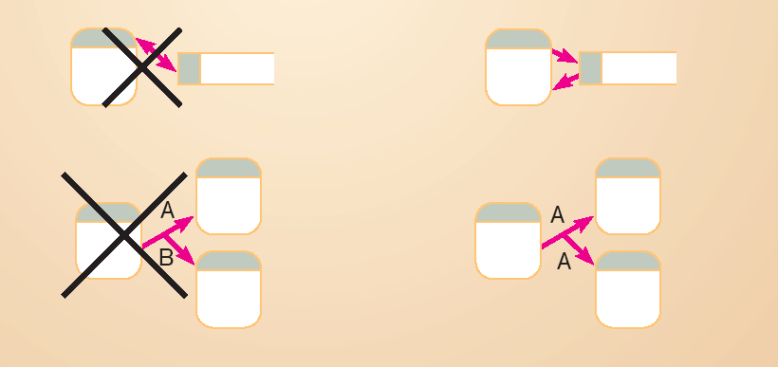
DFD Diagramming Rules Data Flow
Bidirectional flow between process and data store is represented by two separate arrows.
Forked data flow must refer to exact same data item (not different data items) from a common location to multiple destinations.

Slide 13
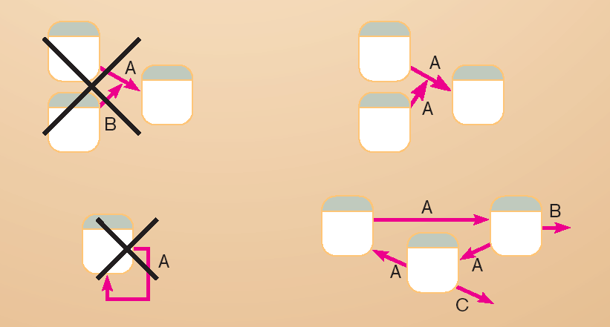
DFD Diagramming Rules Data Flow (cont.)
Joined data flow must refer to exact same data item (not different data items) from multiple sources to a common location.
Data flow cannot go directly from a process to itself, must go through intervening processes.

Slide 14
DFD Diagramming Rules Data Flow (cont.)
Data flow from a process to a data store means update (insert, delete or change).
Data flow from a data store to a process means retrieve or use.
Data flow labels should be noun phrases.

Slide 15
Functional Decomposition
An iterative process of breaking a system description down into finer and finer detail
High-level processes described in terms of lower-level sub-processes
DFD charts created for each level of detail

Slide 16
DFD Levels
Context DFD
Overview of the organizational system
Level-0 DFD
Representation of system’s major processes at high level of abstraction
Level-1 DFD
Results from decomposition of Level 0 diagram
Level-n DFD
Results from decomposition of Level n-1 diagram

Slide 17
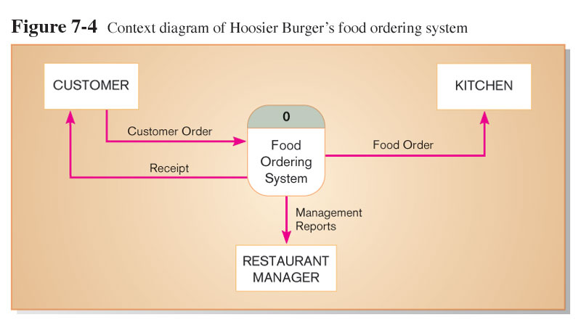
Context Diagram
Context diagram shows the system boundaries, external entities that interact with the system, and major information flows between entities and the system.
NOTE: only one process symbol, and no data stores shown.

Slide 18
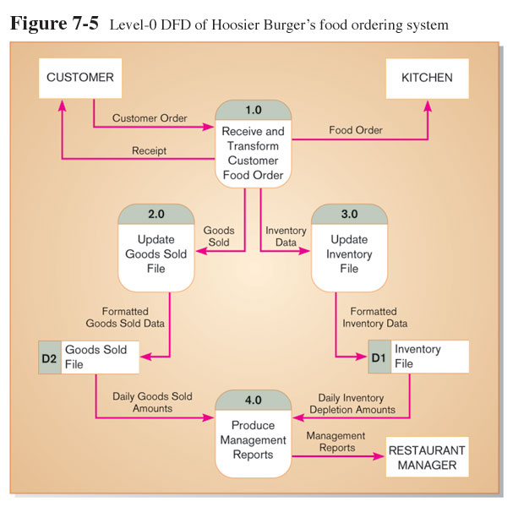
Level-0 DFD
Level-0 DFD shows the system’s major processes, data flows, and data stores at a high level of abstraction.
Processes are labeled 1.0, 2.0, etc. These will be decomposed into more primitive (lower-level) DFDs.

Slide 19
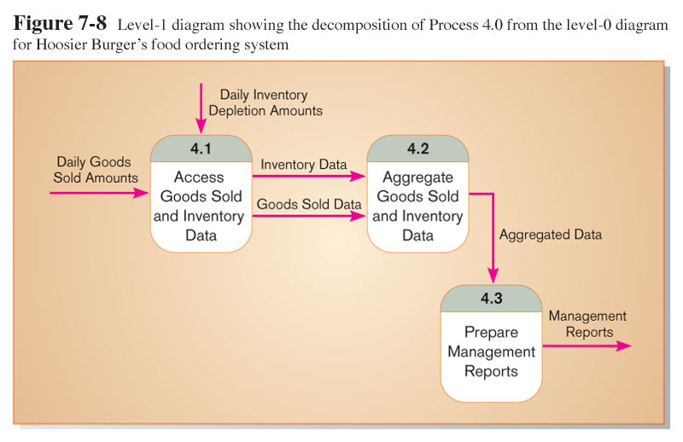
Level-1 DFD
Level-1 DFD shows the sub-processes of one of the processes in the Level-0 DFD.
This is a Level-1 DFD for Process 4.0.
Processes are labeled 4.1, 4.2, etc. These can be further decomposed in more primitive (lower-level) DFDs if necessary.

Slide 20
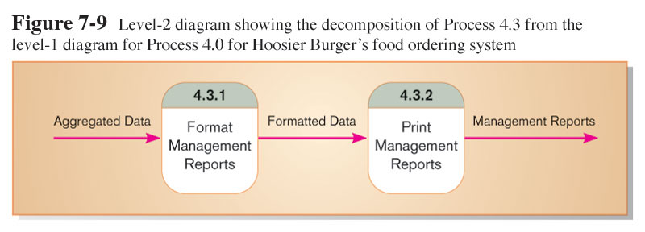
Level-n DFD
Level-n DFD shows the sub-processes of one of the processes in the Level n-1 DFD.
This is a Level-2 DFD for Process 4.3.
Processes are labeled 4.3.1, 4.3.2, etc. If this is the lowest level of the hierarchy, it is called a primitive DFD.

Slide 21
DFD Balancing
The conservation of inputs and outputs to a data flow process when that process is decomposed to a lower level
Balanced means:
Number of inputs to lower level DFD equals number of inputs to associated process of higher-level DFD
Number of outputs to lower level DFD equals number of outputs to associated process of higher-level DFD

Slide 22
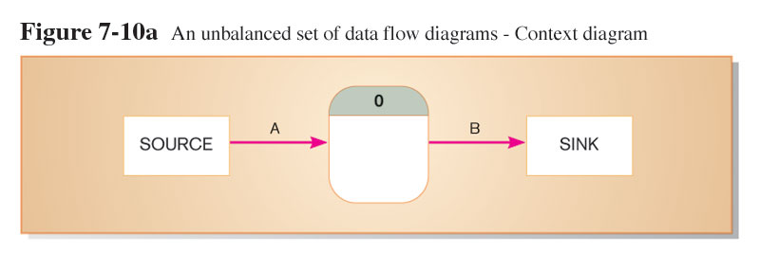
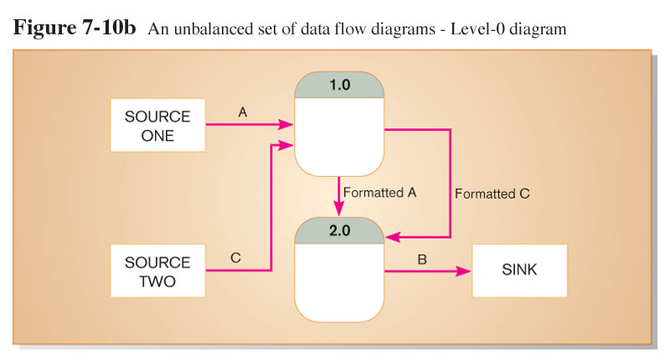
Unbalanced DFD
1 input
1 output
This is unbalanced because the process of the context diagram has only one input but the Level-0 diagram has two inputs.
2 inputs
1 output

Slide 23
Balanced DFD
1 input
2 outputs
These are balanced because the numbers of inputs and outputs of context diagram process equal the number of inputs and outputs of Level-0 diagram.

Slide 24
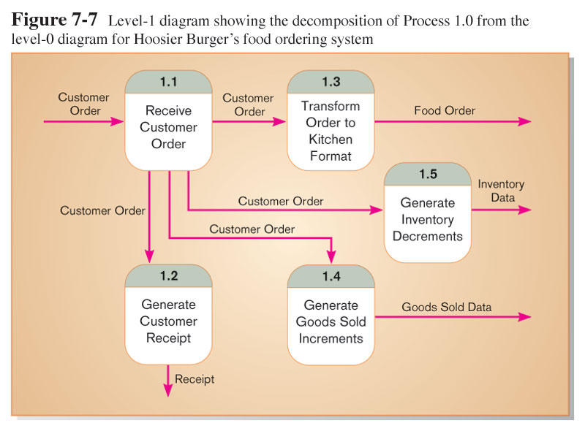
Balanced DFD (cont.)
These are balanced because the numbers of inputs and outputs to Process 1.0 of the Level-0 diagram equals the number of inputs and outputs to the Level-1 diagram.
1 input
4 outputs

Slide 25
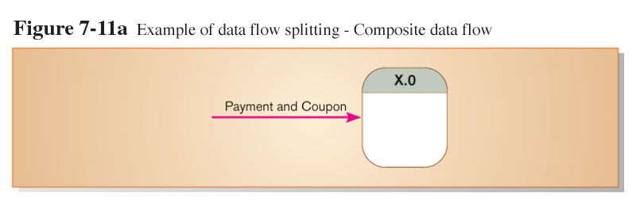
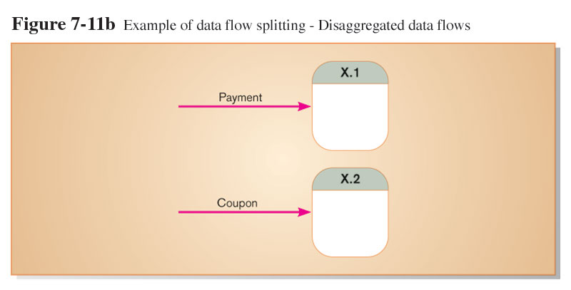
Data Flow Splitting
A composite data flow at a higher level may be split if different parts go to different processes in the lower level DFD.
This remains balanced because the same data is involved, but split into two parts.

Slide 26
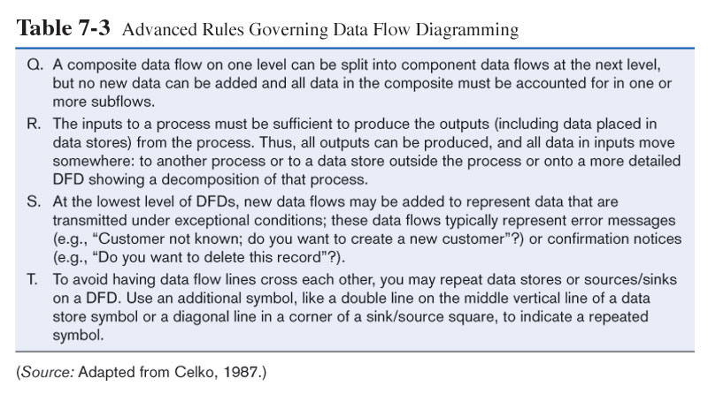
More DFD Rules

Slide 27
Four Different Types of DFD
Current Physical
Process labels identify technology (people or systems) used to process the data.
Data flows and data stores identify actual name of the physical media.
Current Logical
Physical aspects of system are removed as much as possible.
Current system is reduced to data and processes that transform them.

Slide 28
Four Different Types of DFD (cont.)
New Logical
Includes additional functions
Obsolete functions are removed
Inefficient data flows are reorganized
New Physical
Represents the physical implementation of the new system

Slide 29
Guidelines for Drawing DFDs
Completeness
DFD must include all components necessary for system.
Each component must be fully described in the project dictionary or CASE repository.
Consistency
The extent to which information contained on one level of a set of nested DFDs is also included on other levels.

Slide 30
Guidelines for Drawing DFDs (cont.)
Timing
Time is not represented well on DFDs.
Best to draw DFDs as if the system has never started and will never stop.
Iterative Development
Analyst should expect to redraw diagram several times before reaching the closest approximation to the system being modeled.

Slide 31
Guidelines for Drawing DFDs (cont.)
Primitive DFDs
Lowest logical level of decomposition
Decision has to be made when to stop decomposition

Slide 32
Guidelines for Drawing DFDs (cont.)
Rules for stopping decomposition
When each process has been reduced to a single decision, calculation or database operation
When each data store represents data about a single entity
When the system user does not care to see any more detail

Slide 33
Guidelines for Drawing DFDs (cont.)
Rules for stopping decomposition (continued)
When every data flow does not need to be split further to show that data are handled in various ways
When you believe that you have shown each business form or transaction, online display and report as a single data flow
When you believe that there is a separate process for each choice on all lowest-level menu options

Slide 34
Using DFDs as Analysis Tools
Gap Analysis
The process of discovering discrepancies between two or more sets of data flow diagrams or discrepancies within a single DFD
Inefficiencies in a system can often be identified through DFDs.

Slide 35
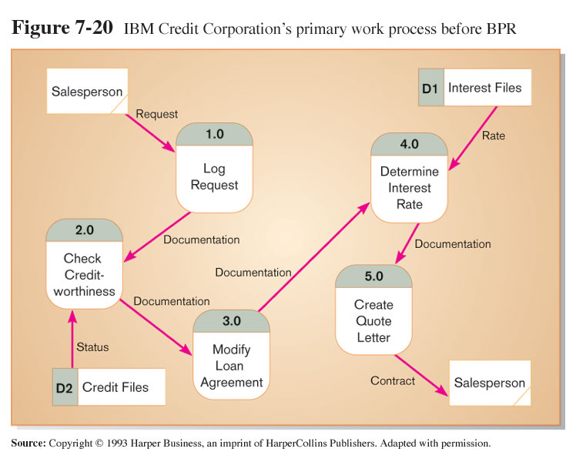
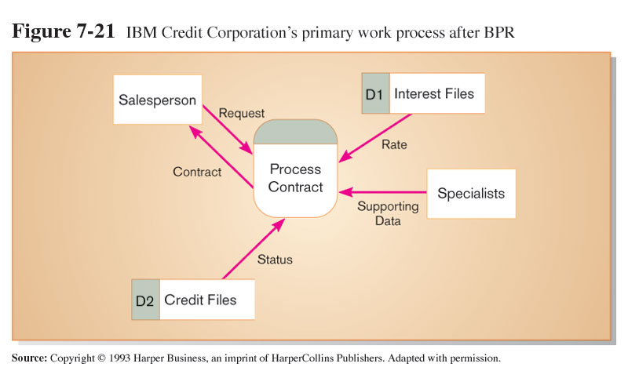
Using DFDs in Business Process Reengineering
Before: Credit approval process required six days
After: process 100 times as many transactions in the same time

Slide 36
Use Cases
Depiction of a system’s behavior or functionality under various conditions as the system responds to requests from users
Full functioning for a specific business purpose

Slide 37
UML Use Case Diagram Symbols
Use Case
Actor
Boundary
Connection
Include relationship
Extend relationship
<<include>>
<<extend>>

Slide 38
What is an Actor?
Actor is an external entity that interacts with the system.
Most actors represent user roles, but actors can also be external systems.
An actor is a role, not a specific user; one user may play many roles, and an actor may represent many users.

Slide 39
What is a Boundary?
A boundary is the dividing line between the system and its environment.
Use cases are within the boundary.
Actors are outside of the boundary.

Slide 40
What is a Connection?
A connection is an association between an actor and a use case.
Depicts a usage relationship
Connection does not indicate data flow

Slide 41
What is an <<extend>> Relationship?
A connection between two use cases
Extends a use case by adding new behavior or actions
Specialized use case extends the general use case

Slide 42
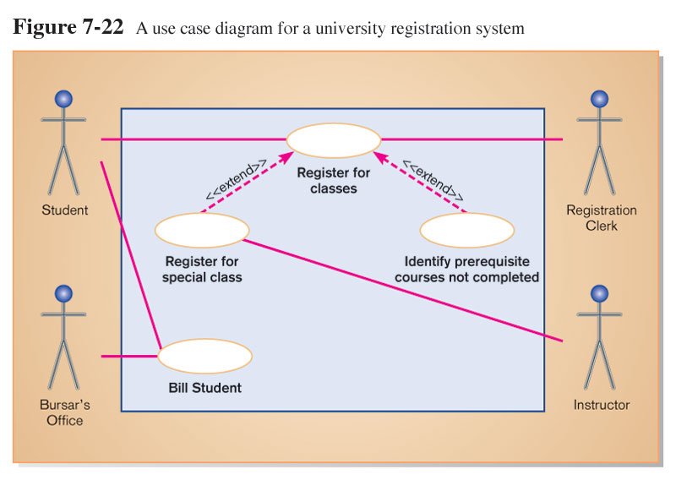

Slide 43
What is an <<include>> Relationship?
A connection between two use cases
Indicates a use case that is used (invoked) by another use case
Links to general purpose functions, used by many other use cases

Slide 44
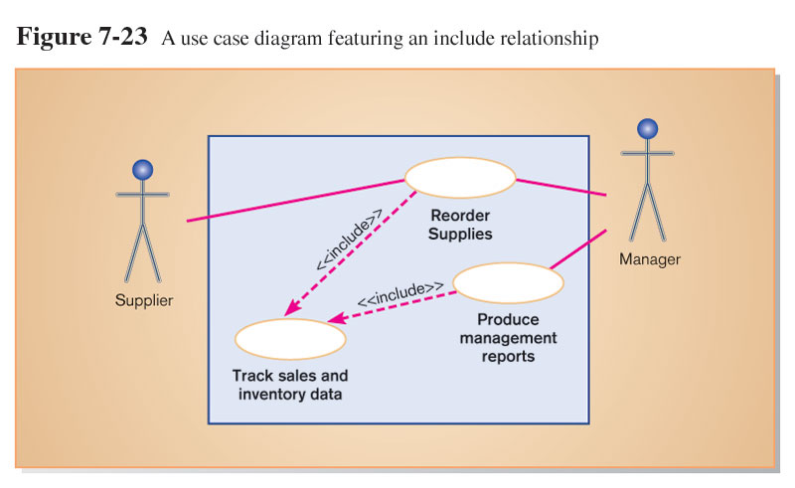

Slide 45
Written Use Cases
Document containing detailed specifications for a use case
Contents can be written as simple text or in a specified format

Slide 46
Summary
In this chapter you learned how to:
Understand logical process modeling via data flow diagrams (DFDs).
Draw DFDs of well structured process models.
Decompose DFDs into lower-level diagrams.
Balance high-level and low-level DFDs.
Explain differences between current physical, current logical, new physical, and new logical DFDs.
Use DFDs for analyzing information systems.
Explain use cases and use case diagrams.

